Slide 1
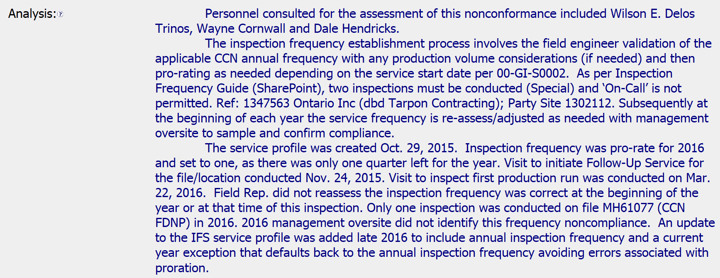
CAR 173917213 OBSERVATION
1. Explain how/if the nonconformity is fully addressed in the analysis.
All stakeholders listed. Provides timeline of events leading to the nonconformance and why the nonconformance occurred as well mention of system changes implemented to reduce such nonconformities.
2. Explain how/if the analysis supports the root cause statement.
The analysis included the 5 whys (3 actually) and leads directly to the stated root cause.

Slide 2
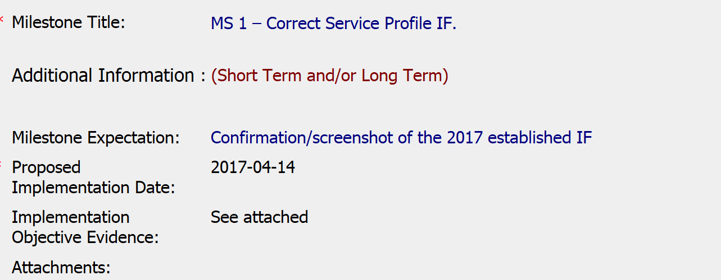
CAR 173917213 OBSERVATION
3. Explain how/if the evidence in the milestone was sufficient to confirm that the nonconformity was eliminated.
The milestone included evidence (screen capture) showing the profile has been updated with the correct IF.
4. Based on the root cause, should the severity of the CAR be changed such that it should now be classified as a Finding?
No. Sample size and nature of the NC still supports this being an observation. The actual audit looked at a large number of profiles for compliance with IFs.

